Slide 1




Cogency: (Cogency = Reasoning, Co- = Cooperative (humans + AI),
-gency = Agentic AI) AI Scientist.
Product: AI Co-Scientist
Mission Statement: Revolutionizing Scientific Discovery with Self-Improving AI
Chrysis Andreou, Mariam SaadAllah, Michalis Chrysostomou, Mohamad Fatfat

Slide 2
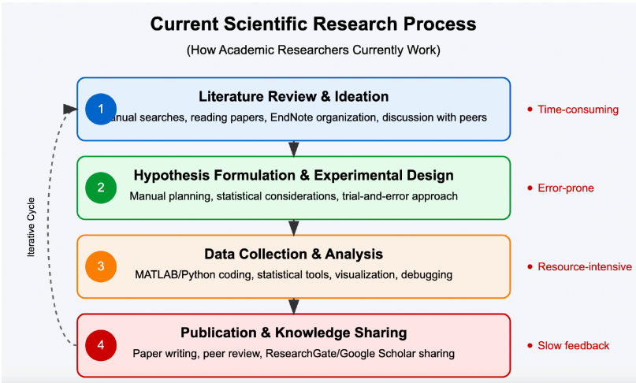
The Problem: Research Bottlenecks
Current Scientific Workflow:
Fragmented & Manual Processes
Time-Consuming (Avg. 50 hrs/cycle tasks)
Error-Prone & Inefficient
Impact:
Slows Pace of Discovery
Hinders Innovation Potential
Frustrates Researchers
Cogency AI Co-Scientist : Revolutionizing Scientific Discovery with Self-Improving AI

Slide 3
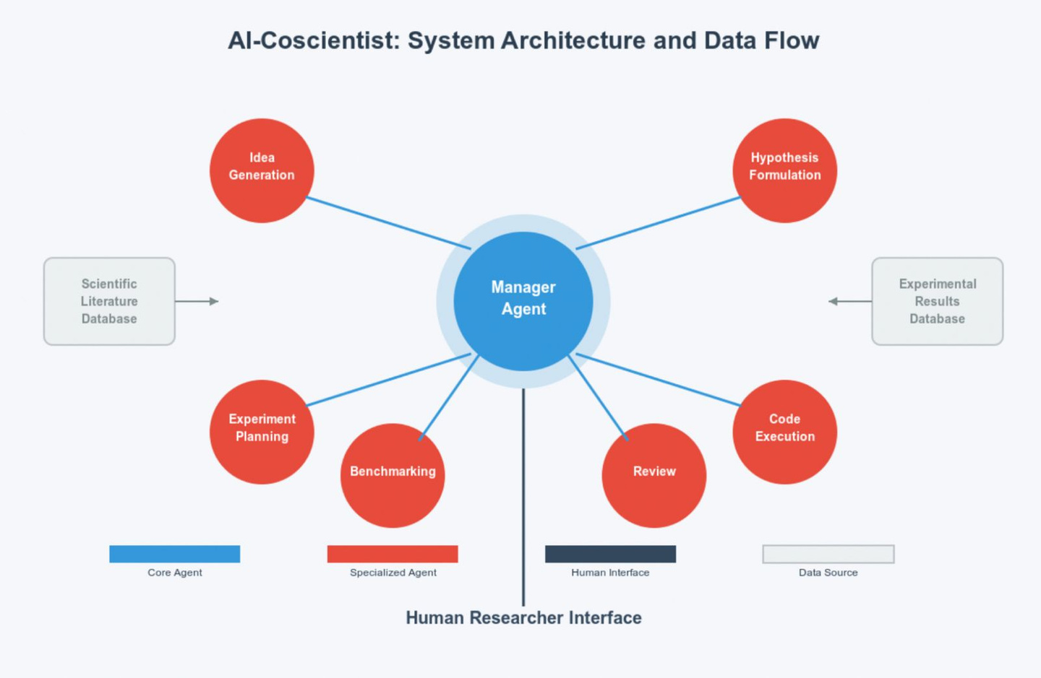
Our Solution: Cogency AI Co-Scientist
AI-Powered Research Partner
Core Innovation: Adaptive Multi-Agent Reasoning
Unique Advantage: Self-Improving via Continuous Learning (Real Research Outcomes)
Key Feature: Human-in-the-Loop Control
Cogency AI Co-Scientist : Revolutionizing Scientific Discovery with Self-Improving AI

Slide 4
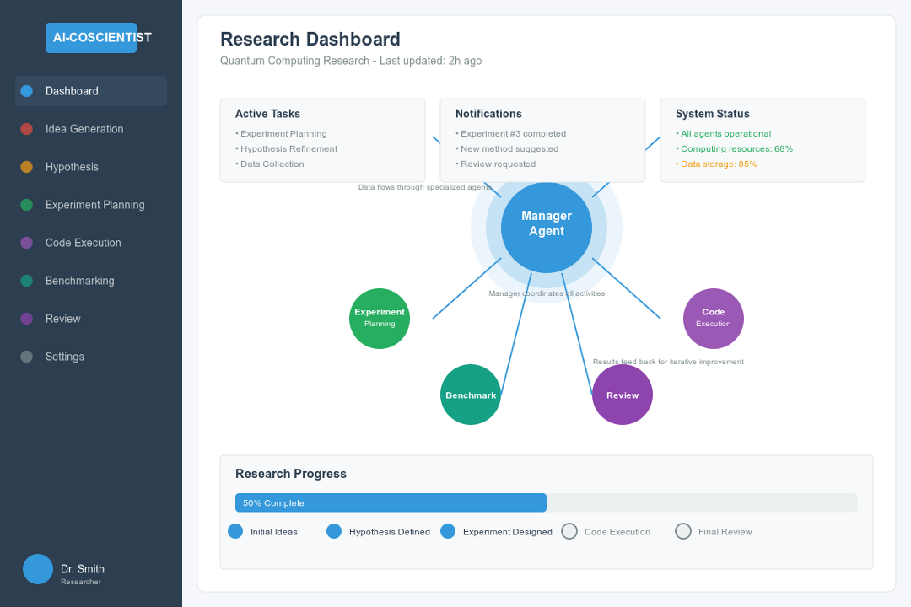
Our Solution: Cogency AI Co-Scientist
Cogency AI Co-Scientist : Revolutionizing Scientific Discovery with Self-Improving AI

Slide 5
Market Opportunity
Beachhead Market:
Beachhead TAM:
Early Adopter Academic
Researchers (600k Users)
~€400 Million Annually
Cogency AI Co-Scientist : Revolutionizing Scientific Discovery with Self-Improving AI
Growth:
Future Expansion:
High Growth AI in
Research Sector
(~30% Compound
Annual Growth Rate)
Industry R&D, Government Labs

Slide 6
Value Proposition & Business Model
Clear Value:
Accelerate Research Tasks (Target: 25%+)
Enhance Research Quality & Novelty
Business Model: Tiered SaaS Subscription
Target Price: €250-€500 / User / Year (Early Adopter Focus)
Potential: Strong Long-Term LTV / COCA Ratio (>3x)
Cogency AI Co-Scientist : Revolutionizing Scientific Discovery with Self-Improving AI

Slide 7
Traction, Team & The Ask
Progress: Market Research, Persona Validation, Positive Initial Feedback (10 Potential Customers Identified)
Team: Dedicated AI Master's Students (AI Dev, Strategy, Software, Product Manager.)
Lean Approach: Focus on Validation via Prototyping & Feedback
Next Step: Build Minimum Viable Business Product (MVBP)
Seeking: €42,000 Seed Funding
Use of Funds: MVBP Development, Pilot Program Execution, Initial User Traction
Join Us: Invest | Partner | Collaborate
Contact Information: candre15@ucy.ac.cy
Cogency AI Co-Scientist : Revolutionizing Scientific Discovery with Self-Improving AI

Slide 8
Cogency AI Co-Scientist : Revolutionizing Scientific Discovery with Self-Improving AI
Thank You
Q&A

